Slide 1
Analyzing NOAA Storm Damage Data
Matthew Tuttle & Lex Bukowski

Slide 2
Project Description
NOAA Provides data on storms that have caused injuries or significant property damage dating back to 1950. The data set describes the location of event, type of weather, and magnitude of damage. There are approximately 1.8 MM weather events recorded.
Prior Work:
“Student Research Abstract: Unsupervised Key Term Extraction of Tornado Narratives from NOAA Storm Events Database” –Emma Louise McDaniel
Narratives were text mined in order to retrieve the impacts of the disasters in order to structure the data for further use
“Some Comments on the Reliability of NOAA's Storm Events Database” –Renato P Dos Santos
Supported by limited statistical analysis, came to the conclusion that the database suffers from incompleteness and inconsistencies
Datasets:
https://www.ncei.noaa.gov/pub/data/swdi/stormevents/csvfiles/

Slide 3
Questions
Have weather events become more dangerous to people?
Is the magnitude of property damage indicative of higher risk of injury to people?
Has the damage caused by severe weather events increased over time?
Have severe weather events increased over time?
Are some areas more prone to severe weather effects?

Slide 4
Data Preparation
Data Cleaning & Preprocessing
Data broken up into yearly reports which were combined in Pandas dataframe
Simplified, combined and made data types consistent between files
Data Integration
Codes for county and regional data were re-labeled for readability and consistency
Census data per county

Slide 5
Tools Used
Pandas
Created a Pandas Dataframe in Python from the CSV Storm Event Data Files
Allowed for efficient data cleaning and preliminary analysis
NumPy
Python tool to help clean, pre-process, and simplify the data set
StatsModels
Statistical modeling and regression calculations for correlation analysis to answer the proposed questions
Seaborn and Plotly
Tool to create graphs and data visualizations

Slide 6
Data Mining Analysis Applied
Regression Models
Determine relevant correlations between data attributes to predict future storm event damage cost and injury counts
Outlier Analysis
Normal EDA tools such as histogram and box plots were not effective due to dominance of outliers in dataset

Slide 7
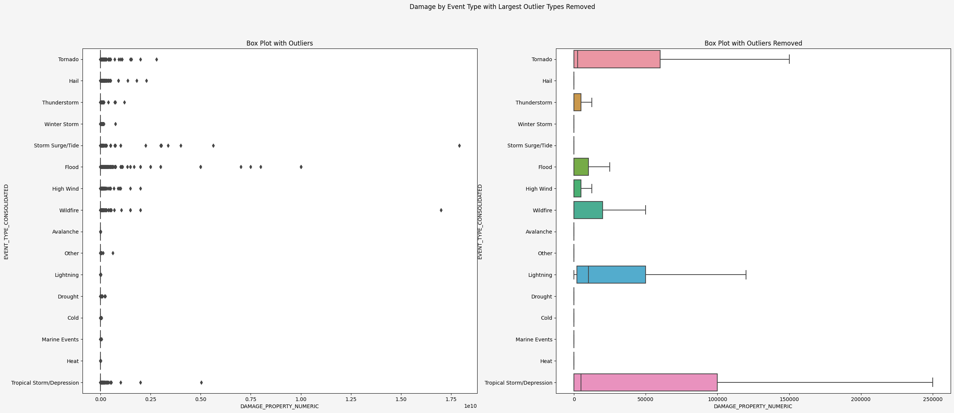

Slide 8
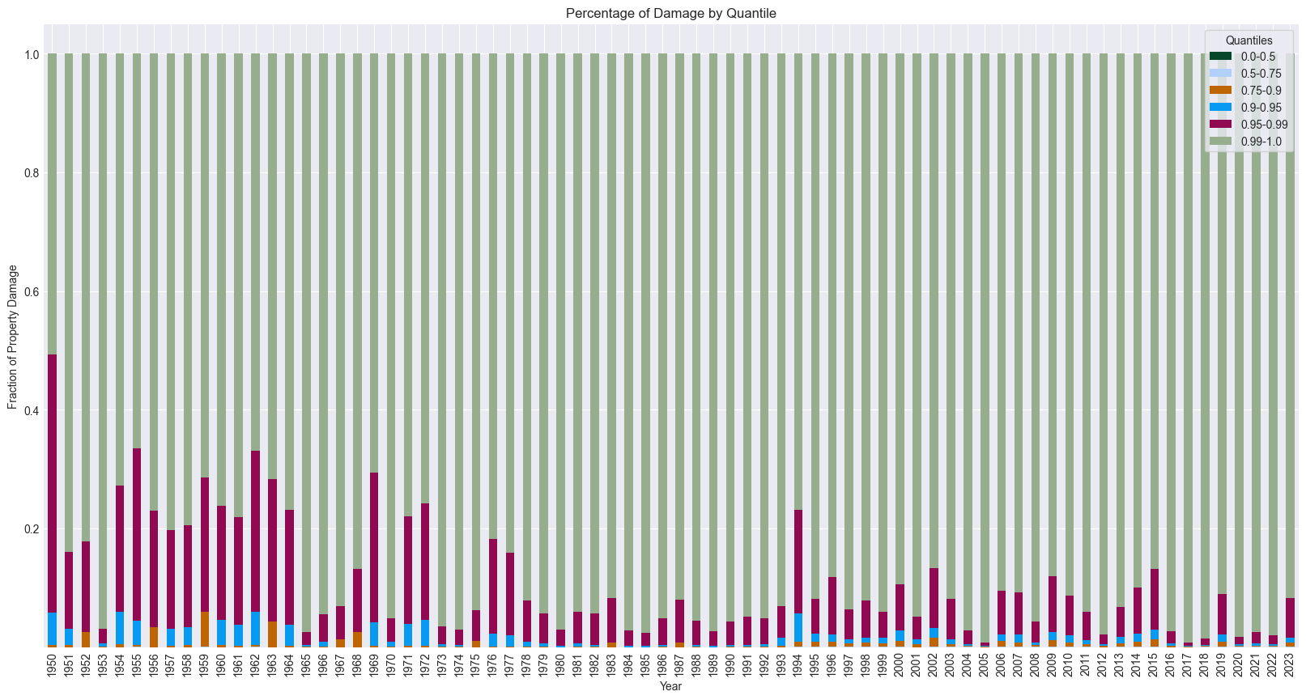

Slide 9
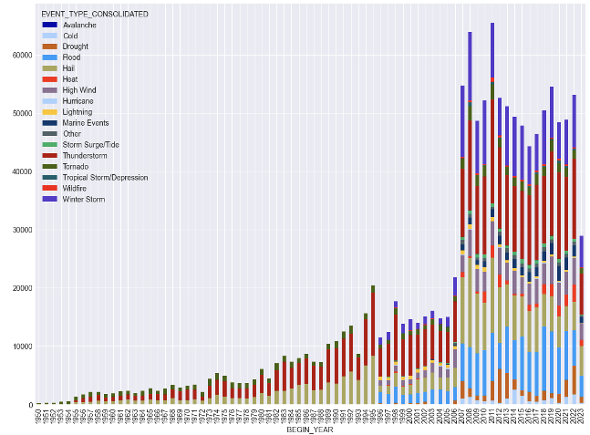
Knowledge Gained – Events per Year
Has the frequency of storm events increased over time?
No trend to show an increase in total weather events each year
Recording of event types has changed significantly in the lifetime of dataset

Slide 10
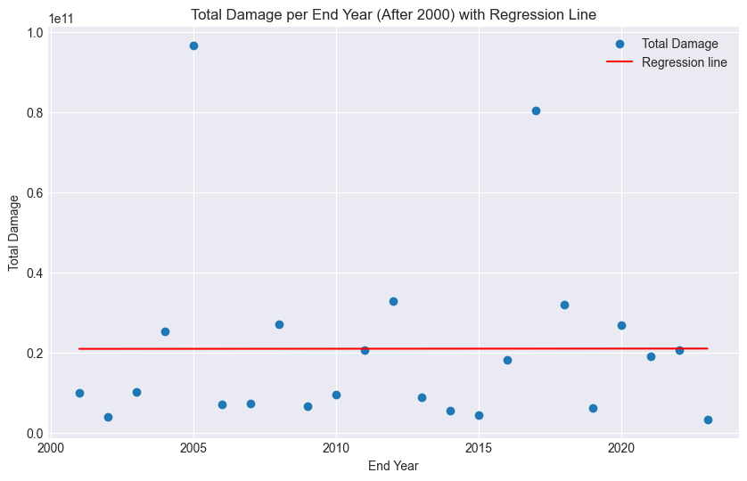
Knowledge Gained – Damage per Year
Has the damage caused by storm events increased over time?
R-squared value = 0.000
No correlation

Slide 11
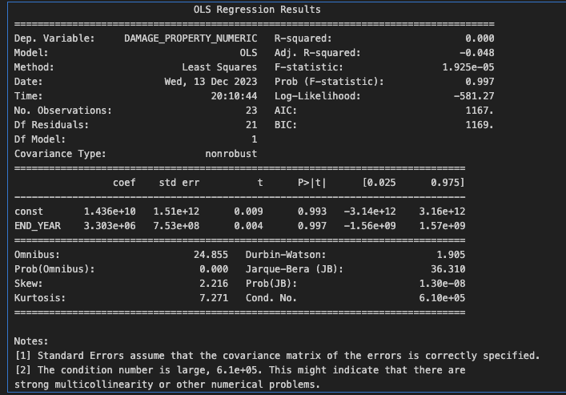

Slide 12
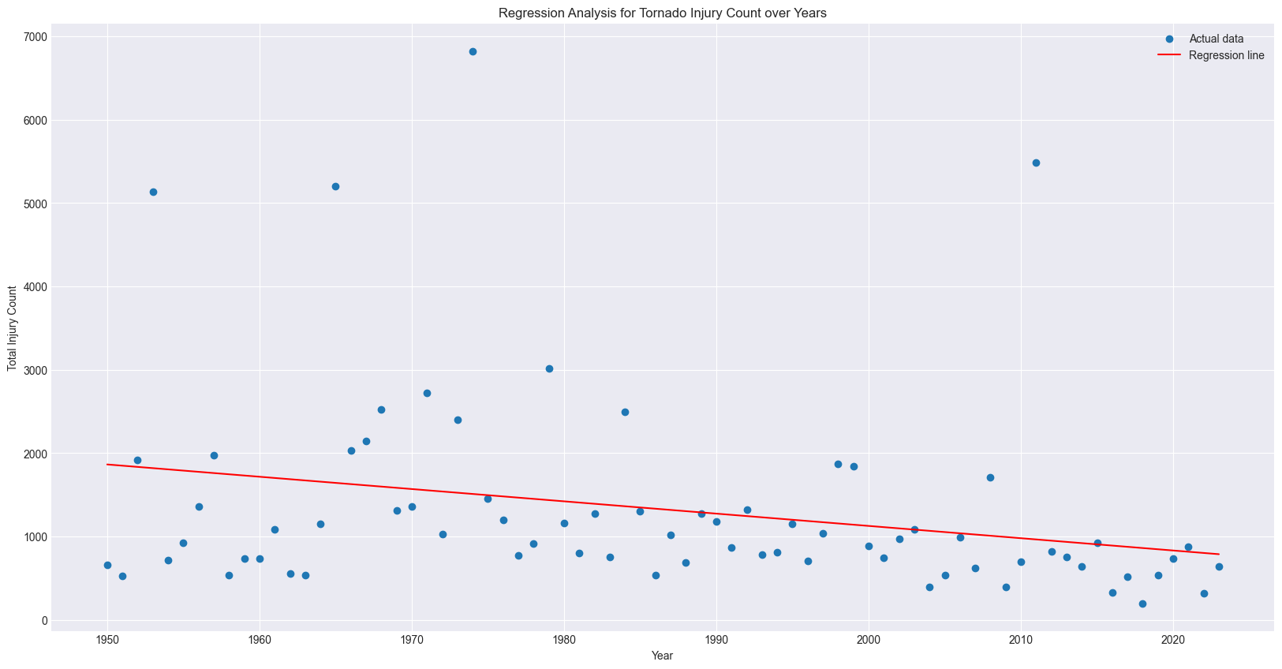
Knowledge Gained – Injury Count
Have weather events become more dangerous to people?
R-squared = 0.068
Outliers skew regression model

Slide 13
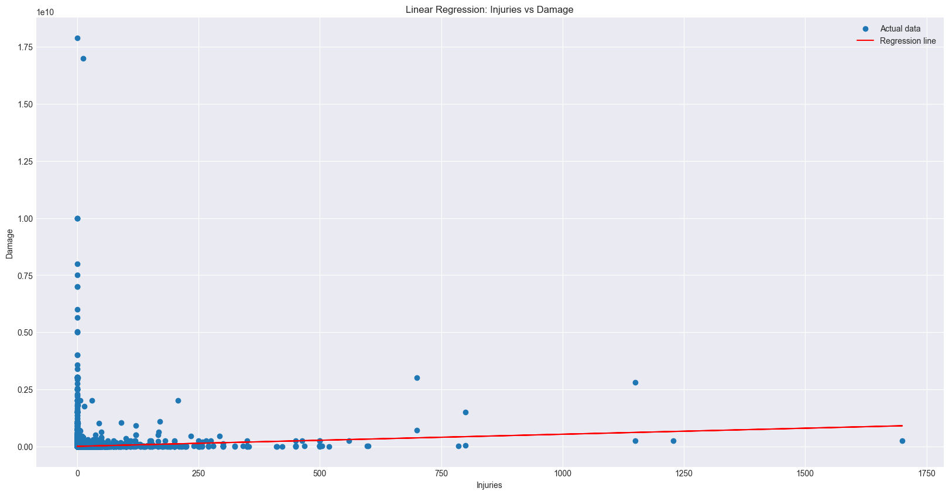
Knowledge Gained – Injuries vs Damage
Is the magnitude property damage indicative of higher risk of injury to people?
R-squared value = 0.004, no significant correlation

Slide 14
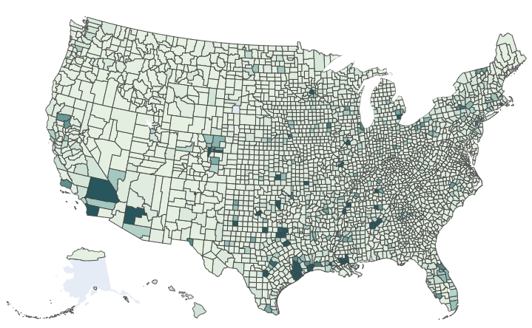
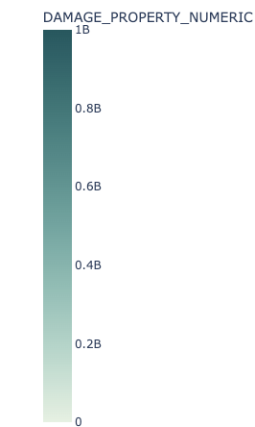
Total Property Damage by County

Slide 15
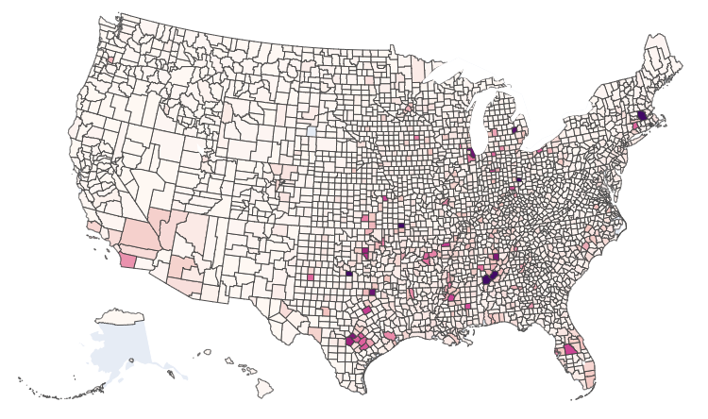
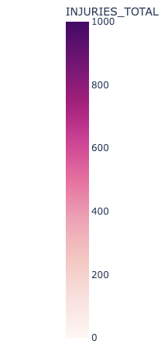
Total Injuries by County

Slide 16
Knowledge Application
Better understanding of the risk of severe weather events and allow for better prediction of the outcomes of severe weather events.
Future weather events, even if more severe, can cause less damage to people and property, potentially saving lives and preventing huge expenditures.
Occurrence and location of weather events can give insight into possible other causation factors

Slide 17
Acknowledgements
Louise McDaniel and Renato P Dos Santos for their previous work and insights into this data set
SAC '23: Proceedings of the 38th ACM/SIGAPP Symposium on Applied Computing. March 2023 Pages 653 – 656 https://doi.org/10.1145/3555776.3577211
P dos Santos, Renato, Some Comments on the Reliability of NOAA's Storm Events Database (June 22, 2016). Available at SSRN: https://ssrn.com/abstract=2799273 or http://dx.doi.org/10.2139/ssrn.2799273

